Slide 1


Did jacob wohl send death threats to himself?
Mohammed Nauman Siddique
Web Archiving Forensics (CS 895)
Spring, 2019
Web Science and Digital Libraries Group
Old Dominion University
Norfolk, Virginia, USA
@WebSciDL
2019/03/20

Slide 2
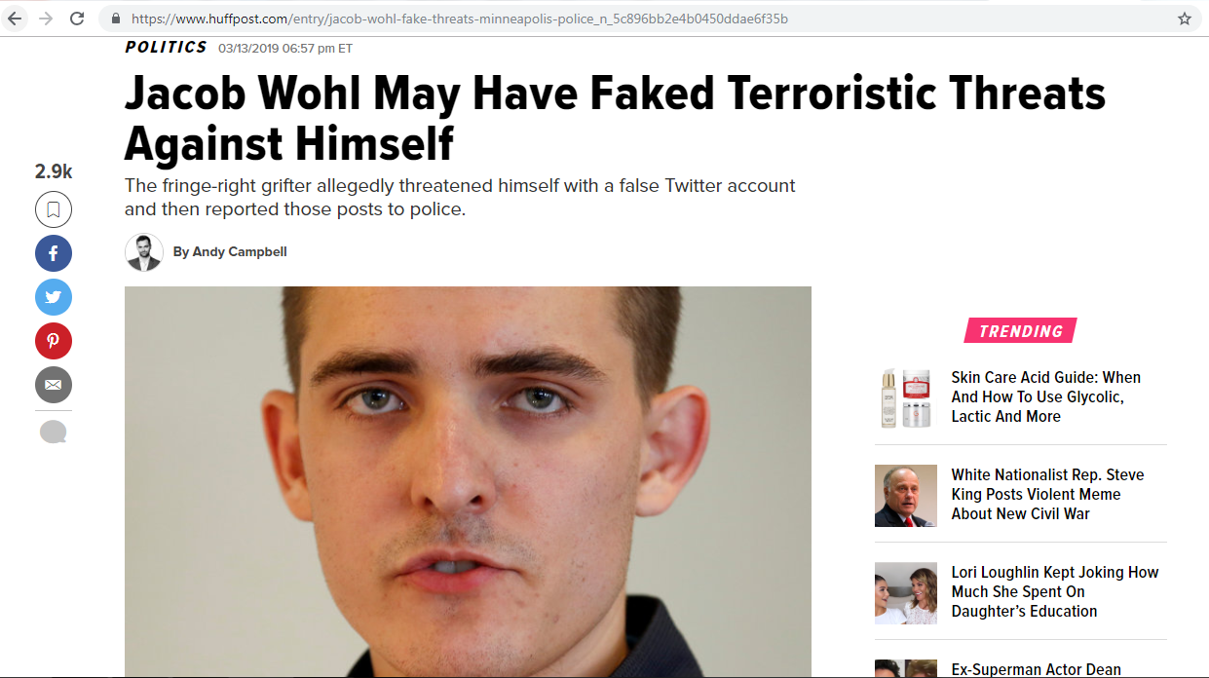
Did Jacob Wohl fake his threat?
Source: https://www.huffpost.com/entry/jacob-wohl-fake-threats-minneapolis-police_n_5c896bb2e4b0450ddae6f35b

Slide 3
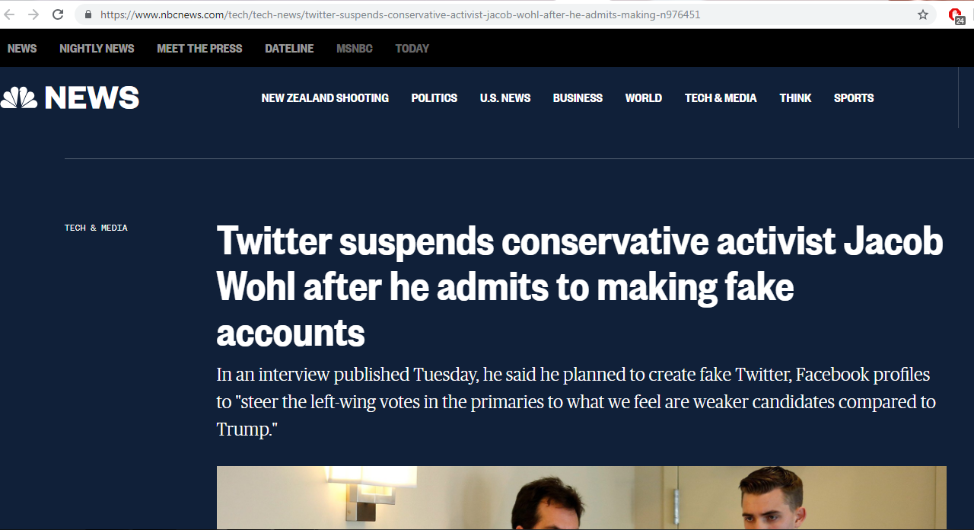
Twitter suspends Jacob Wohl
Source: https://www.nbcnews.com/tech/tech-news/twitter-suspends-conservative-activist-jacob-wohl-after-he-admits-making-n976451

Slide 4
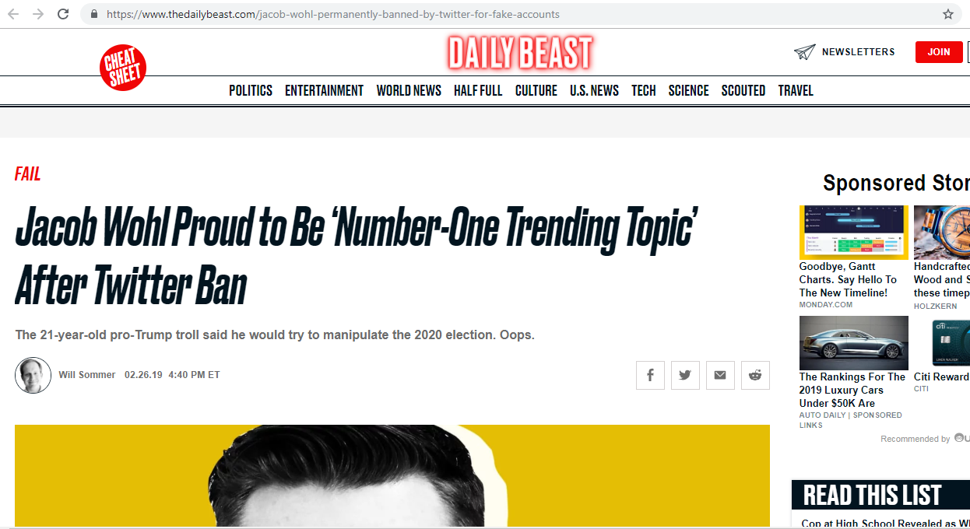
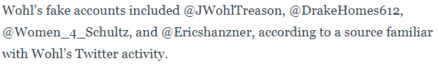
Daily Beast reports Wohl’s fake Twitter accounts
Source: https://www.thedailybeast.com/jacob-wohl-permanently-banned-by-twitter-for-fake-accounts

Slide 5
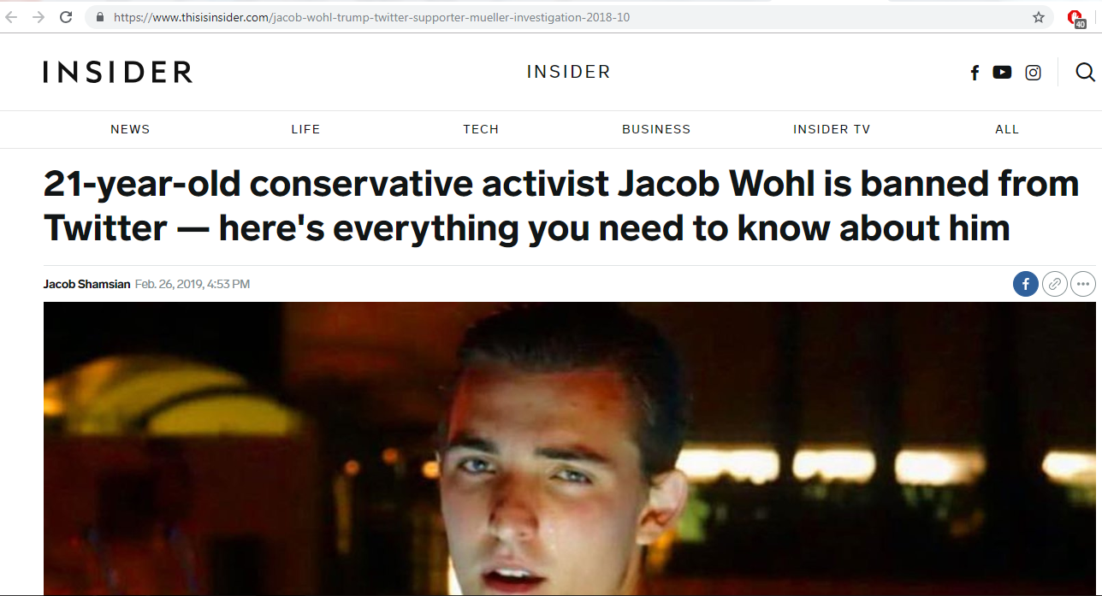
All you need to know about Jacob Wohl
Source: https://www.thisisinsider.com/jacob-wohl-trump-twitter-supporter-mueller-investigation-2018-10

Slide 6
Jacob Wohl’s fake Twitter account suspended
msiddique@wsdl-3102-03:/$ curl -I https://twitter.com/Women_4_Schultz
HTTP/1.1 302 Found
cache-control: no-cache, no-store, must-revalidate, pre-check=0, post-check=0
content-length: 103
content-type: text/html;charset=utf-8
date: Tue, 19 Mar 2019 05:39:18 GMTexpires: Tue, 31 Mar 1981 05:00:00 GMT
last-modified: Tue, 19 Mar 2019 05:39:18 GMT
location: https://twitter.com/account/suspended
…Deletia…

Slide 7
@Women_4_Schultz has no mementos
msiddique@wsdl-3102-03:/$ curl -I https://memgator.cs.odu.edu/timemap/link/https://twitter.com/Women_4_Schultz
HTTP/1.1 404 Not Found
Access-Control-Allow-Origin: *Access-Control-Expose-Headers: Link, Location, X-Memento-Count, X-Generator
Content-Length: 19
Content-Type: text/plain; charset=utf-8
Date: Tue, 19 Mar 2019 05:42:55 GMT
X-Content-Type-Options: nosniff
X-Generator: MemGator:1.0-rc7
X-Memento-Count: 0

Slide 8
@JWohlTreason has no mementos
msiddique@wsdl-3102-03:/$ curl -I https://memgator.cs.odu.edu/timemap/link/https://twitter.com/JWohlTreason
HTTP/1.1 404 Not Found
Access-Control-Allow-Origin: *Access-Control-Expose-Headers: Link, Location, X-Memento-Count, X-Generator
Content-Length: 19
Content-Type: text/plain; charset=utf-8
Date: Tue, 19 Mar 2019 08:45:07 GMT
X-Content-Type-Options: nosniff
X-Generator: MemGator:1.0-rc7
X-Memento-Count: 0

Slide 9
@Ericshanzner has no mementos
msiddique@wsdl-3102-03:/$ curl -I https://memgator.cs.odu.edu/timemap/link/https://twitter.com/Ericshanzner
HTTP/1.1 404 Not Found
Access-Control-Allow-Origin: *Access-Control-Expose-Headers: Link, Location, X-Memento-Count, X-Generator
Content-Length: 19
Content-Type: text/plain; charset=utf-8
Date: Tue, 19 Mar 2019 08:48:43 GMT
X-Content-Type-Options: nosniff
X-Generator: MemGator:1.0-rc7
X-Memento-Count: 0

Slide 10
Jacob Wohl’s Twitter account is suspended
msiddique@wsdl-3102-03:/$ curl -I https://twitter.com/JacobAWohl
HTTP/1.1 302 Found
cache-control: no-cache, no-store, must-revalidate, pre-check=0, post-check=0
content-length: 103
content-type: text/html;charset=utf-8
date: Mon, 18 Mar 2019 17:27:16 GMTexpires: Tue, 31 Mar 1981 05:00:00 GMTlast-modified: Mon, 18 Mar 2019 17:27:16 GMT
location: https://twitter.com/account/suspended
…Deletia…

Slide 11
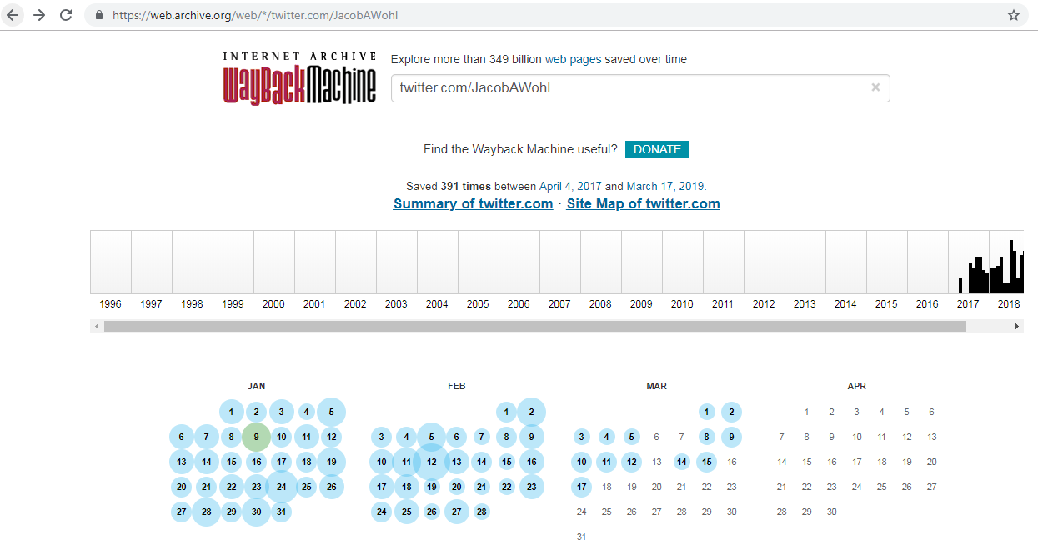
Internet Archive has 319 mementos for @JacobAWohl
Source: https://web.archive.org/web/*/twitter.com/JacobAWohl

Slide 12
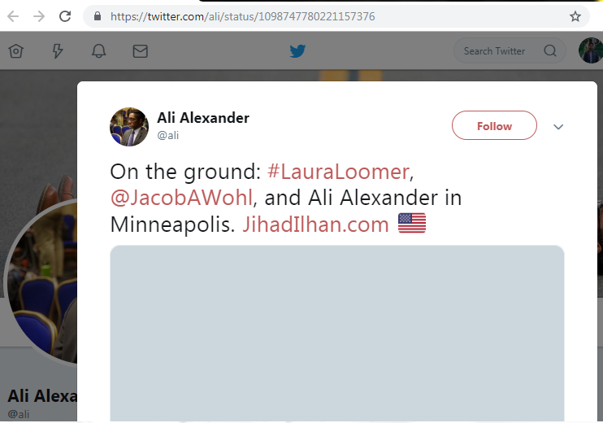
Reach Milnneapolis on 2019/02/21
Source: https://twitter.com/ali/status/1098747780221157376

Slide 13
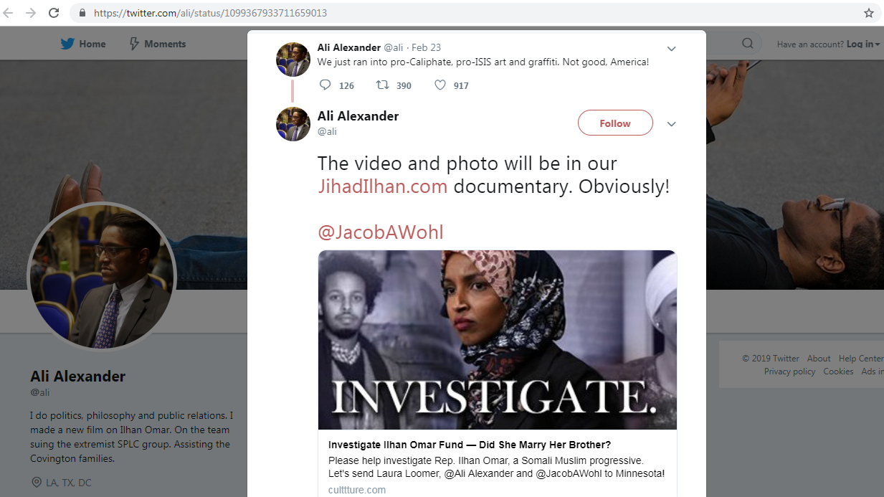
@ali, @JacobAWohl, and @LauraLoomer were filming a documentary on @ilhan
Source: https://twitter.com/ali/status/1099367933711659013

Slide 14
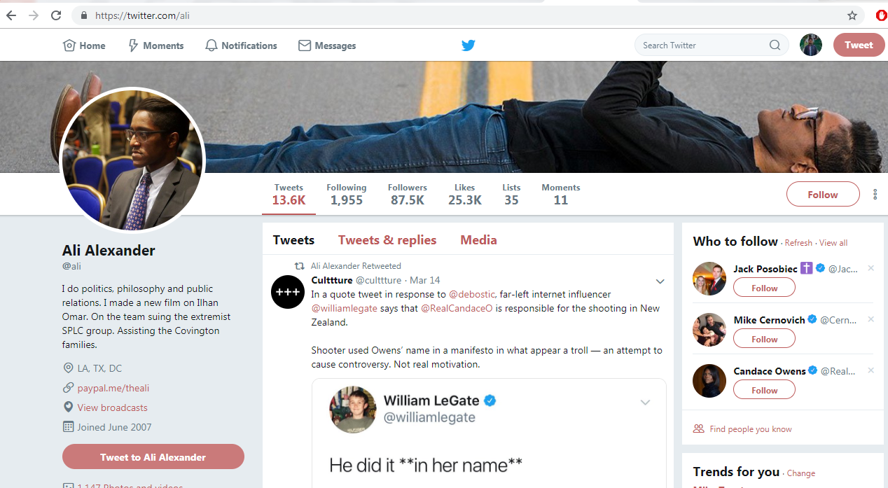
@ali shoots hard-right agenda videos
Source: https://twitter.com/ali

Slide 15
Laura Loomer suspended since 2019/11/29
msiddique@wsdl-3102-03:/$ curl -I https://twitter.com/LauraLoomer
HTTP/1.1 302 Found
cache-control: no-cache, no-store, must-revalidate, pre-check=0, post-check=0
content-length: 103
content-type: text/html;charset=utf-8
date: Mon, 18 Mar 2019 17:47:27 GMTexpires: Tue, 31 Mar 1981 05:00:00 GMT
last-modified: Mon, 18 Mar 2019 17:47:27 GMT
location: https://twitter.com/account/suspended
…Deletia…

Slide 16
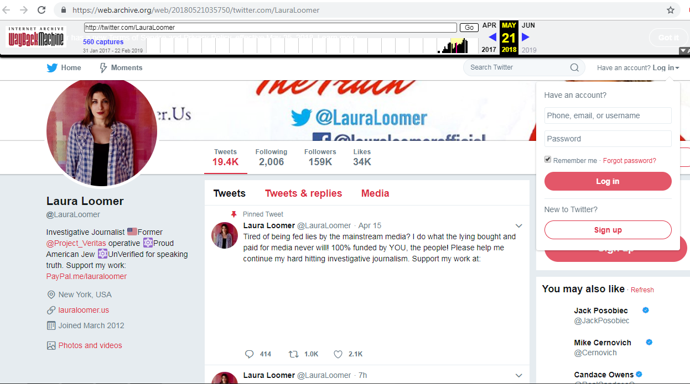
@LauraLoomer investigative journalist
Source: https://web.archive.org/web/20180521035750/twitter.com/LauraLoomer

Slide 17
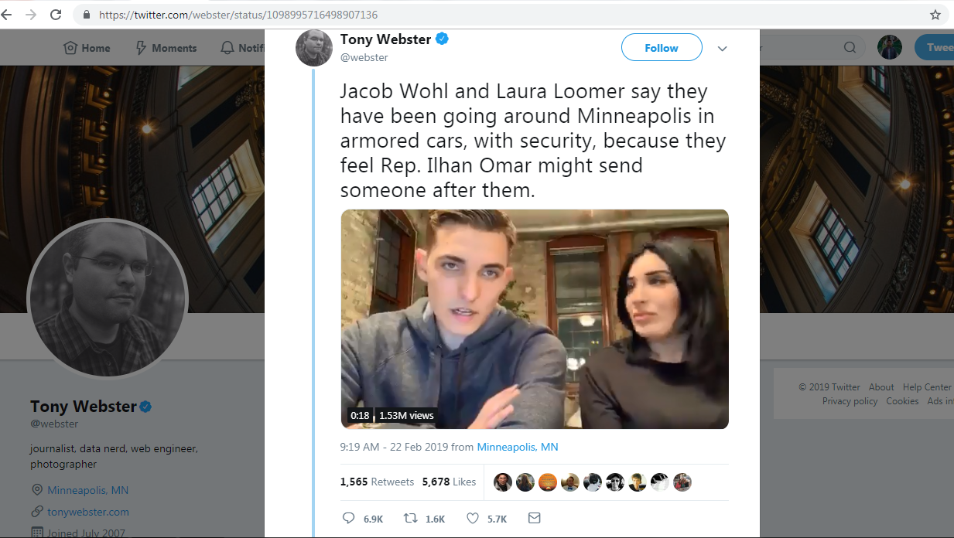
Going around in Minneapolis with security
Source: https://twitter.com/webster/status/1098995716498907136

Slide 18
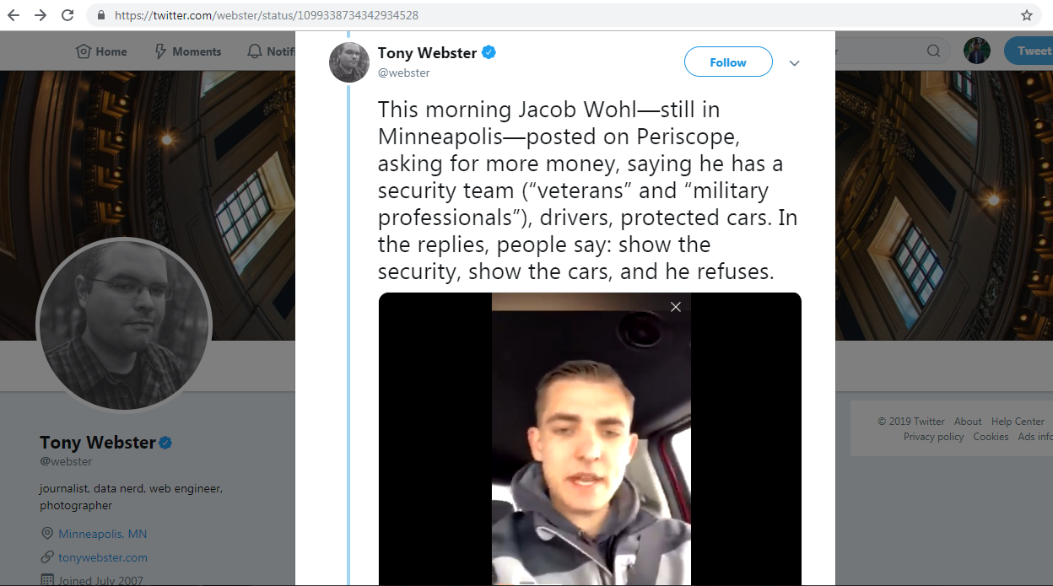
Refuses to show his security
Source: https://twitter.com/webster/status/1099338734342934528

Slide 19
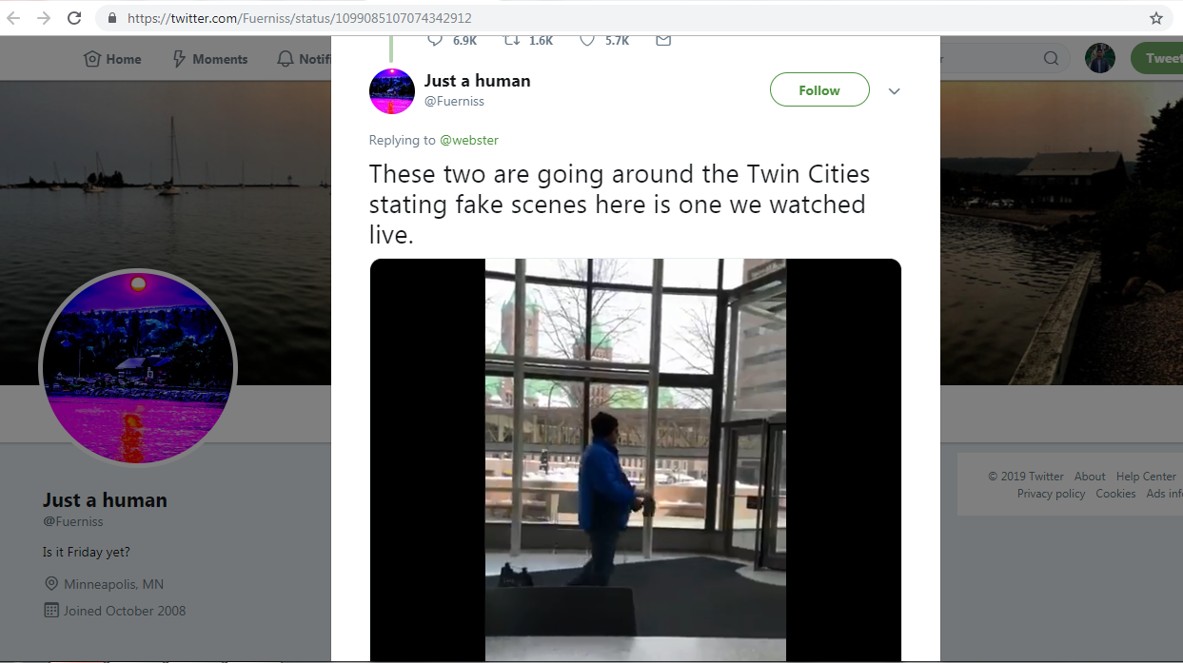
No security to be seen
Source: https://twitter.com/Fuerniss/status/1099085107074342912

Slide 20
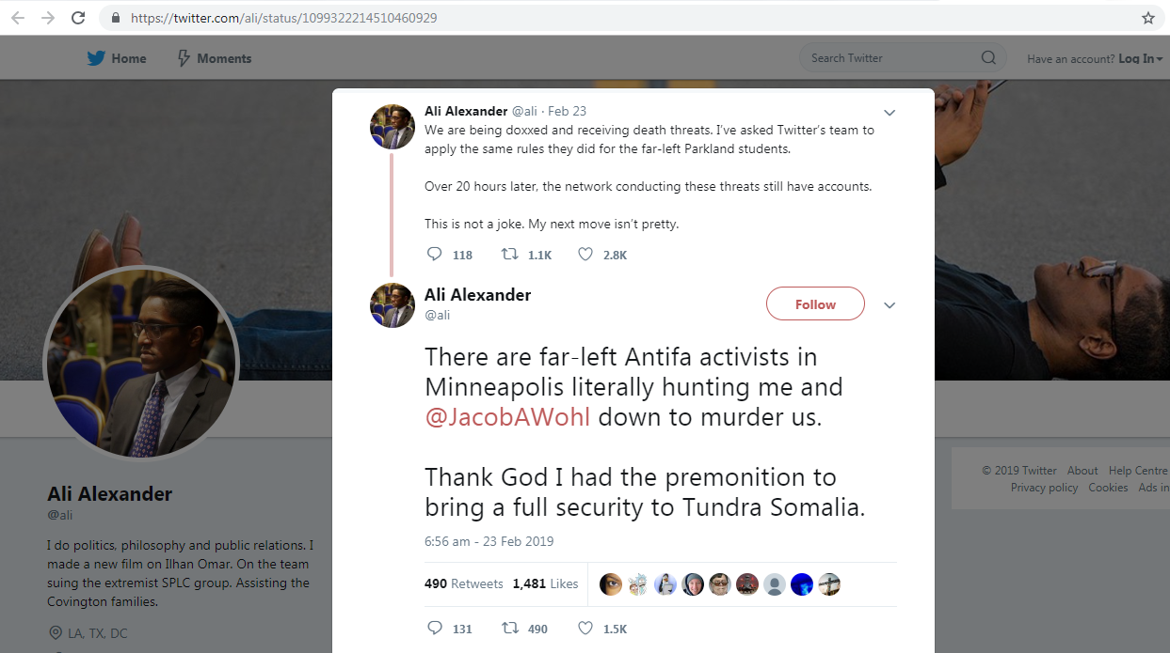
@ali tweets about threats
Source: https://twitter.com/ali/status/1099322214510460929

Slide 21
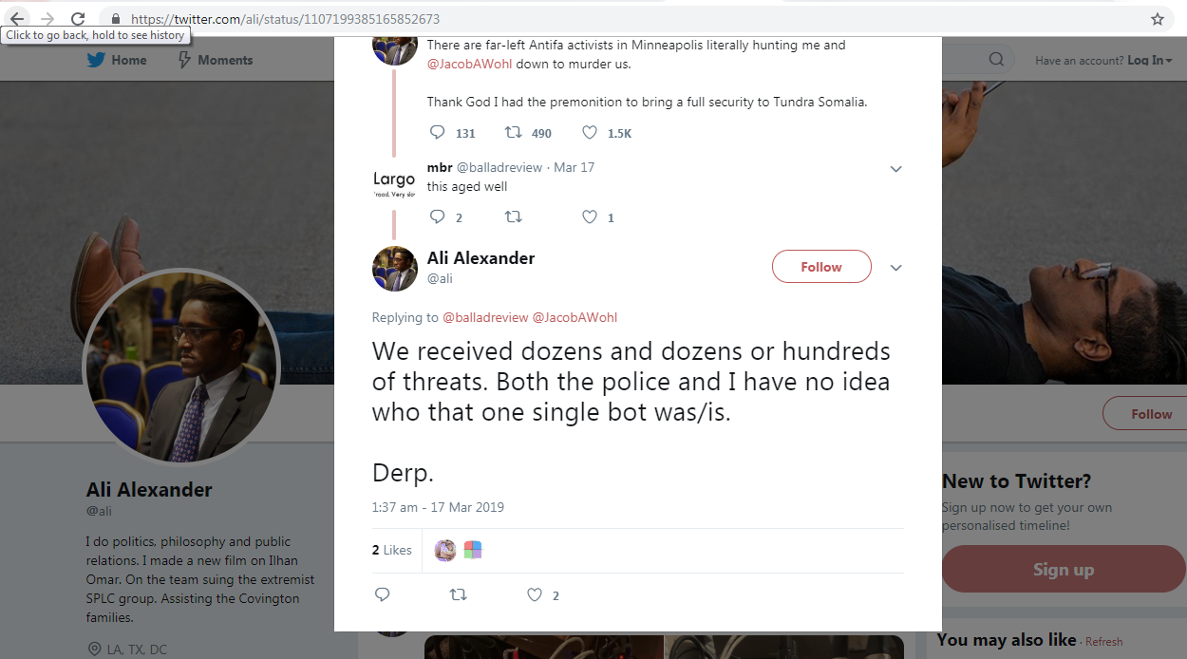
@ali says dozens of threat messages received
Source: https://twitter.com/ali/status/1107199385165852673

Slide 22
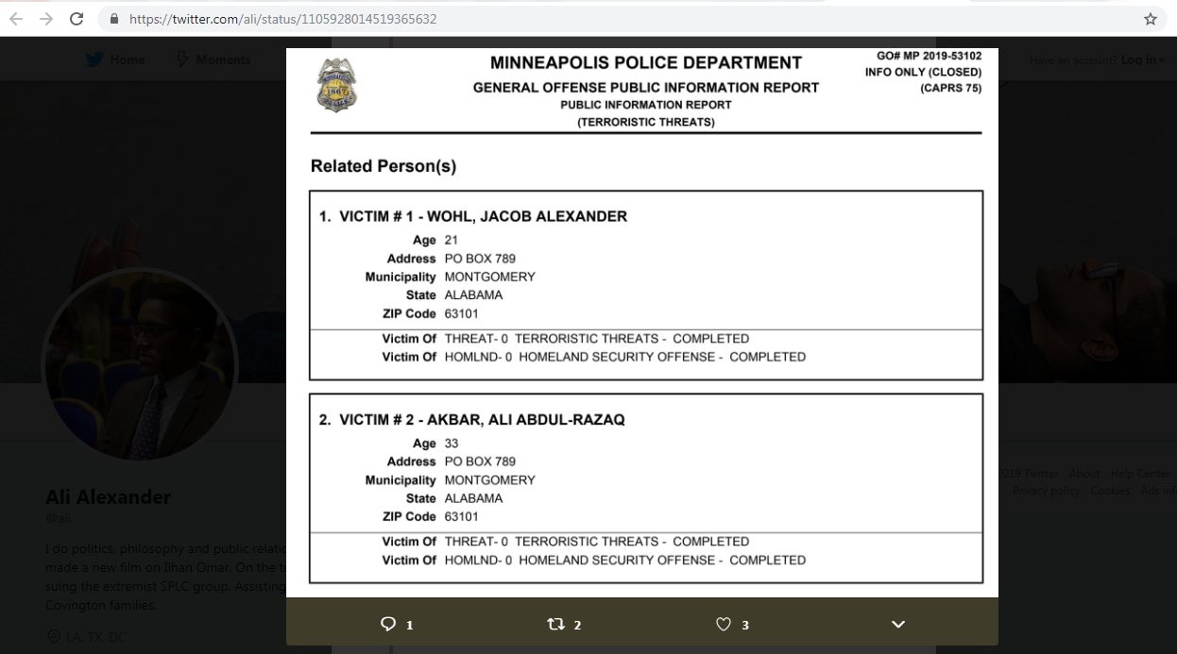
Screenshot of police report on the threat
Source: https://twitter.com/ThePotenciado/status/1105973285353852928

Slide 23
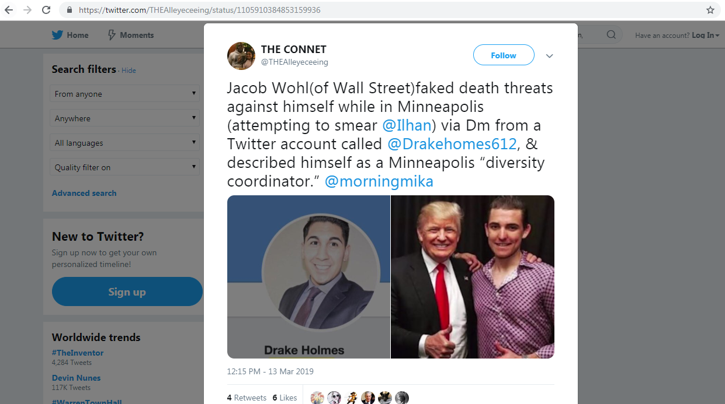
@DrakeHomes612 threat message
Source: https://twitter.com/THEAlleyeceeing/status/1105910384853159936

Slide 24
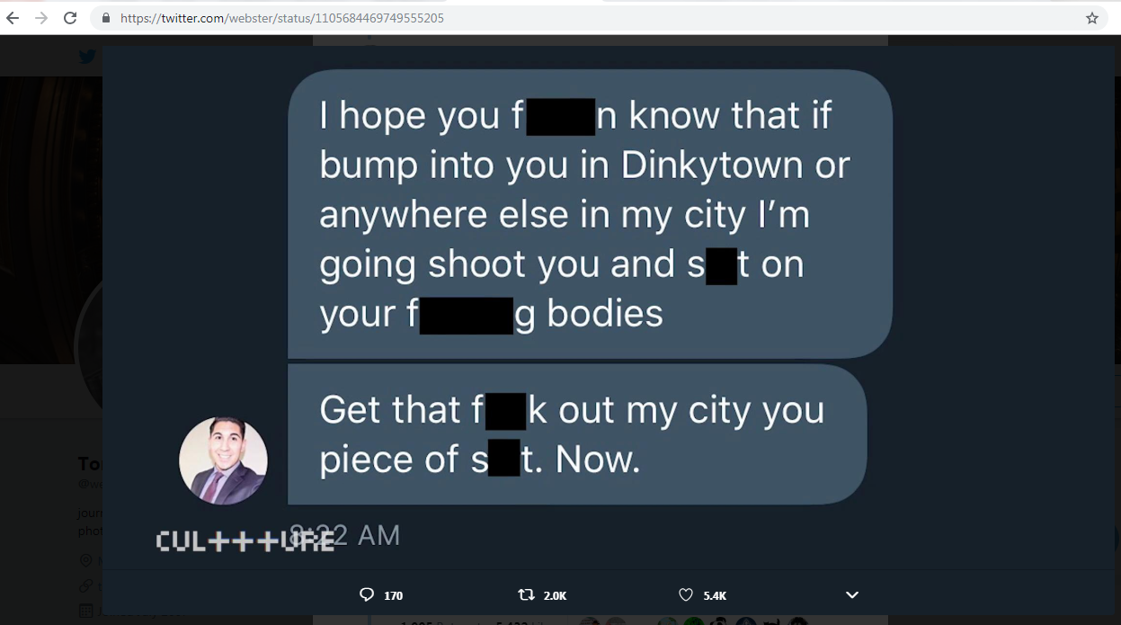
Threat message sent to Jacob Wohl
Source: https://twitter.com/webster/status/1105684469749555205

Slide 25
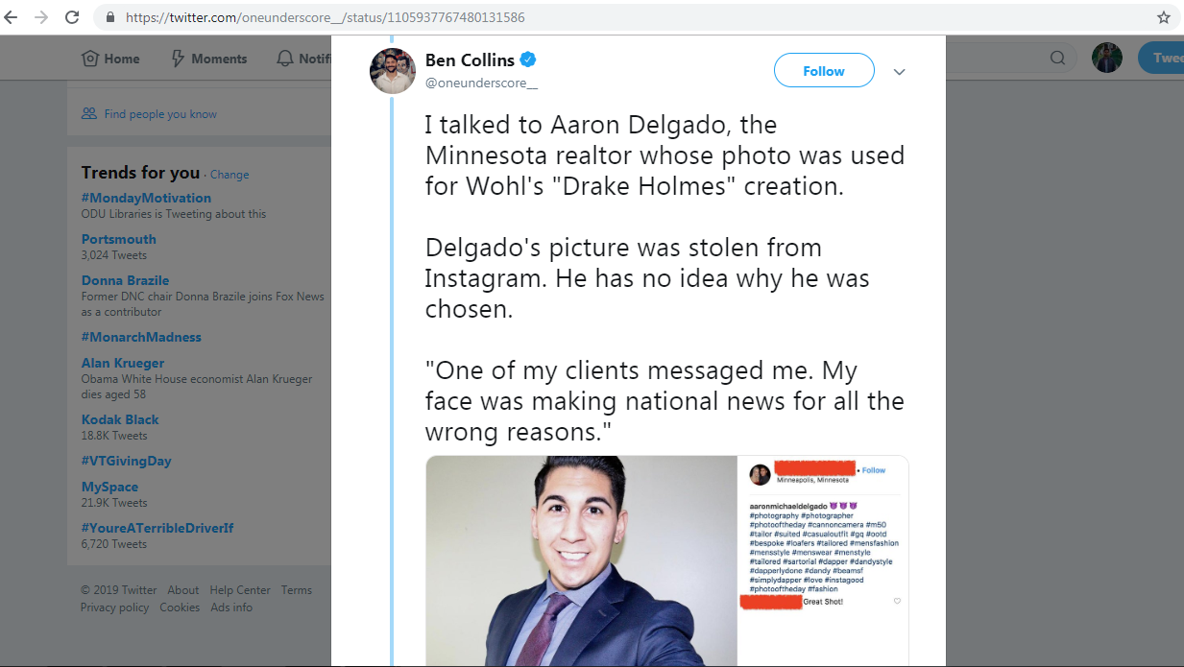
Minnesota Realtor’s photo was used on fake account
Source: https://twitter.com/oneunderscore__/status/1105937767480131586

Slide 26
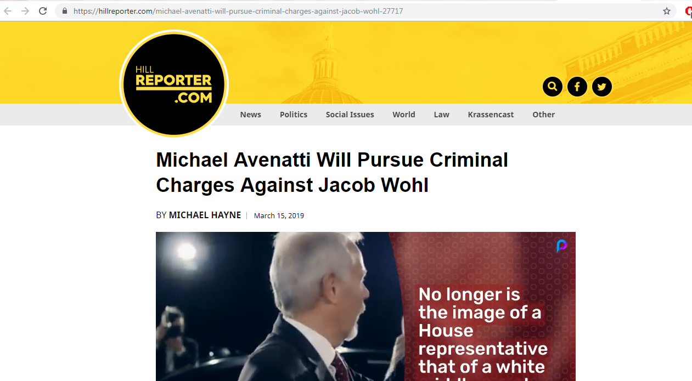
Legal charges will be pressed for impersonation
Source: https://hillreporter.com/michael-avenatti-will-pursue-criminal-charges-against-jacob-wohl-27717

Slide 27
Fake account that sent threat is suspended
msiddique@wsdl-3102-03:/$ curl -I https://twitter.com/DrakeHomes612
HTTP/1.1 302 Found
cache-control: no-cache, no-store, must-revalidate, pre-check=0, post-check=0
content-length: 103
content-type: text/html;charset=utf-8
date: Mon, 18 Mar 2019 17:31:31 GMTexpires: Tue, 31 Mar 1981 05:00:00 GMT
last-modified: Mon, 18 Mar 2019 17:31:31 GMT
location: https://twitter.com/account/suspended
…Deletia…

Slide 28
No memento for @DrakeHomes612
msiddique@wsdl-3102-03:/$ curl -I https://memgator.cs.odu.edu/timemap/link/https://twitter.com/DrakeHomes612
HTTP/1.1 404 Not Found
Access-Control-Allow-Origin: *Access-Control-Expose-Headers: Link, Location, X-Memento-Count, X-Generator
Content-Length: 19
Content-Type: text/plain; charset=utf-8
Date: Tue, 19 Mar 2019 05:50:28 GMT
X-Content-Type-Options: nosniff
X-Generator: MemGator:1.0-rc7
X-Memento-Count: 0

Slide 29
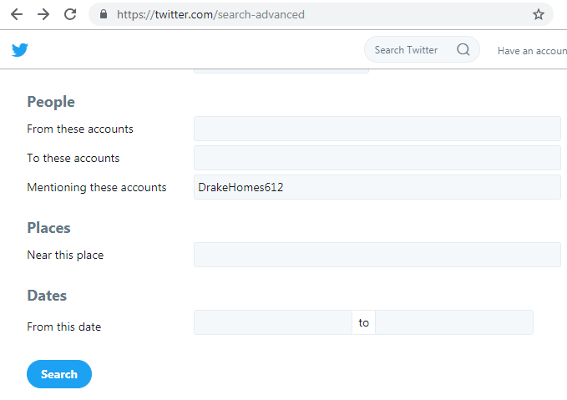
Checking Twitter’s advanced search
Source: https://twitter.com/search-advanced

Slide 30
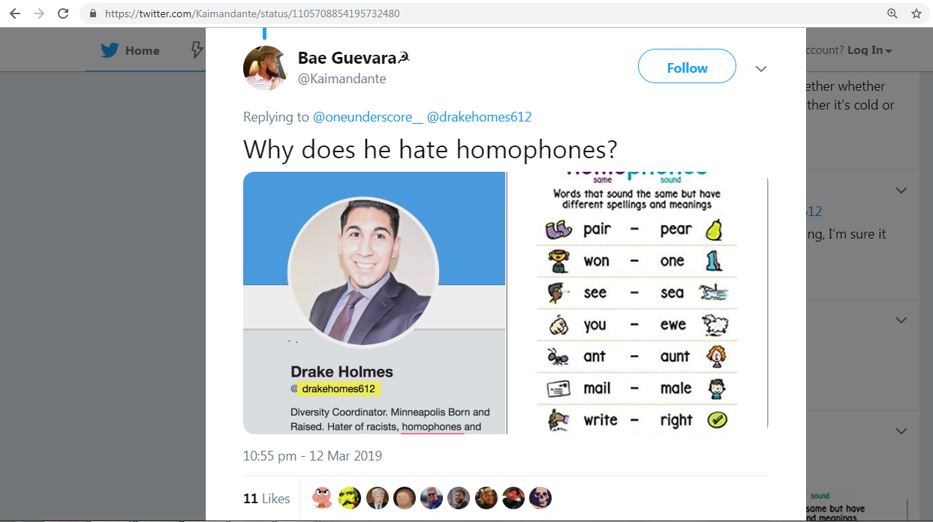
Could not even spell his name correctly
Source: https://twitter.com/Kaimandante/status/1105708854195732480

Slide 31
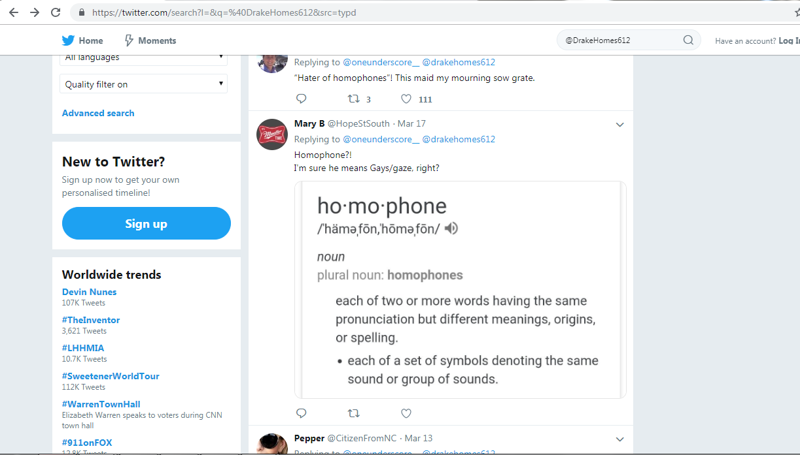
@DrakeHomes612 was live on 17th March 2019

Slide 32
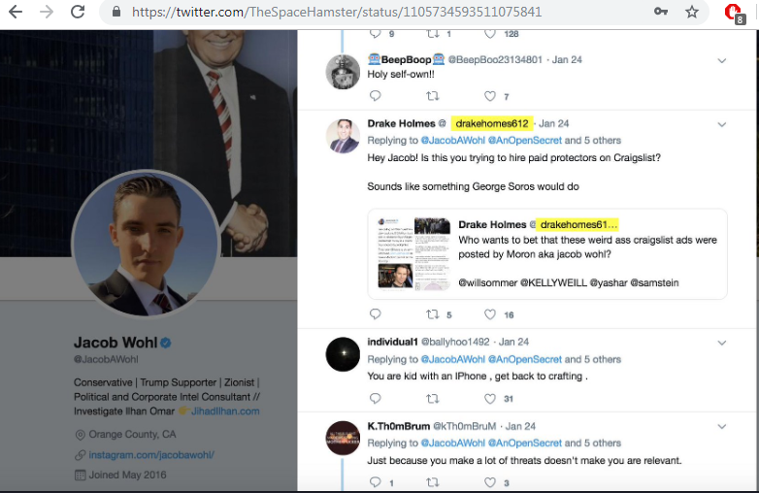
A tweet from @DrakeHomes612 to @JacobAWohl
Source: https://twitter.com/TheSpaceHamster/status/1105734593511075841

Slide 33
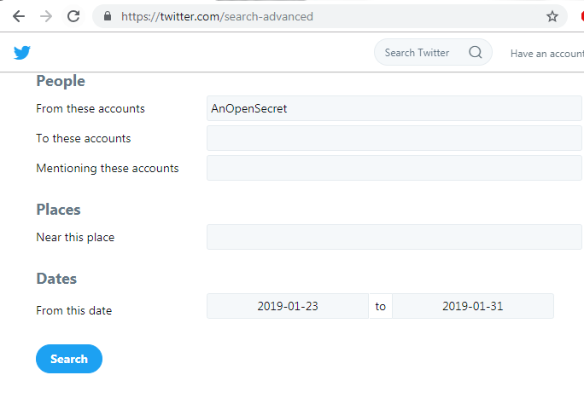
No reply from him to @DrakeHomes612

Slide 34
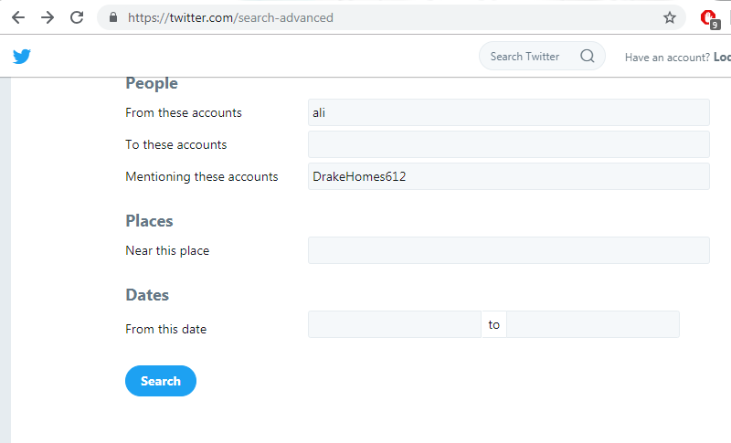
Did @ali mention @Drakehomes612 in his tweets?

Slide 35
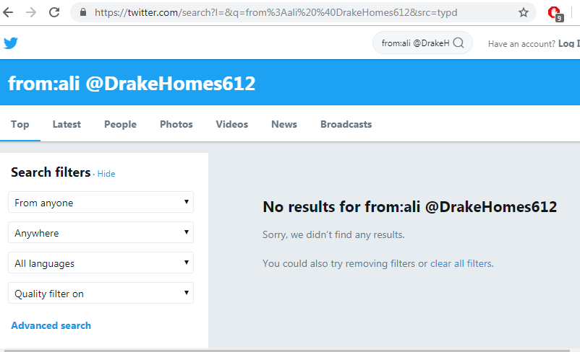
Nope!! No results..

Slide 36
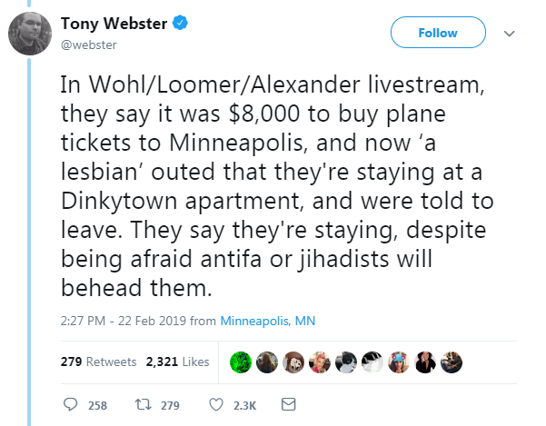
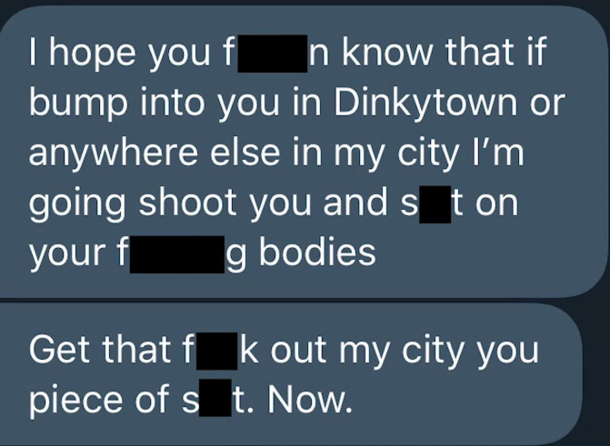

Slide 37
Backup Slides

Slide 38
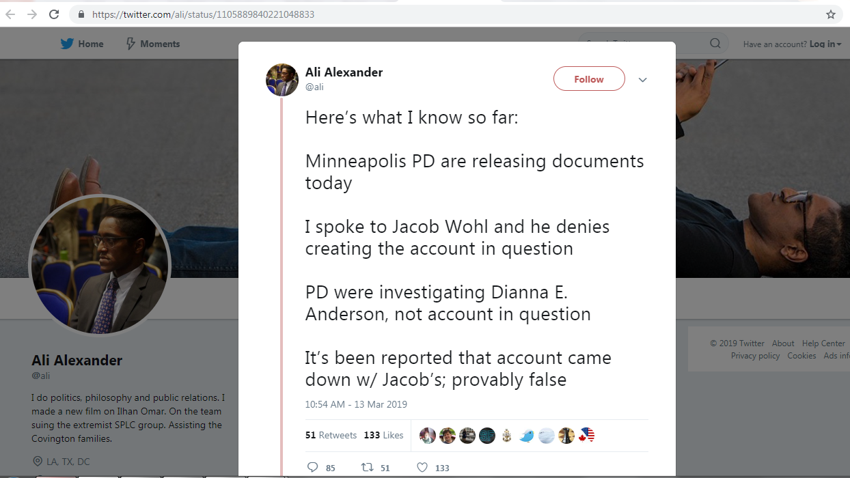
Source: https://twitter.com/ali/status/1105889840221048833

Slide 39
Events timeline slide from beginning to end
2019/01/24 - @DrakeHomes612’s tweet mentions @JacobAWohl
2019/02/26 - Twitter suspends Jacob Wohl over fake accounts
2019/02/26 – Ali claims death threats in Minnesota
2019/02/26 – Daily Beast reports @DrakeHomes612 as fake account of Jacob Wohl
2019/03/13 – Police case filed for death threats
2019/03/17 – Last mention for @DrakeHomes612 in tweets

